Slide 1
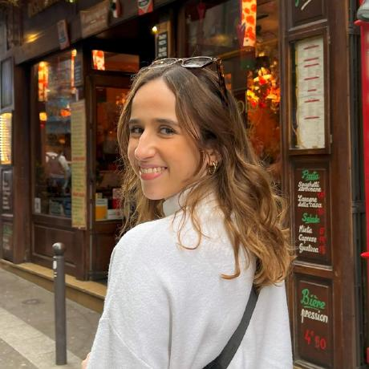



SKIN-SCANCER Skin Cancer Detection App with Deep Learning model
Team
Rita Bastos
Haitao Sun
Yui Takeuchi-Schöpe
Ines Bel Hadj Soulami

Slide 2
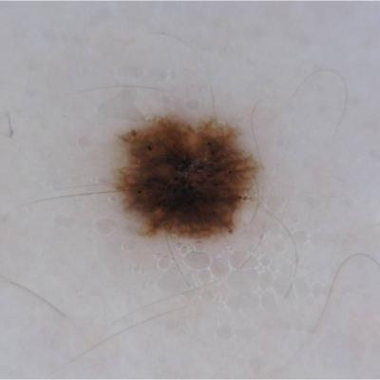
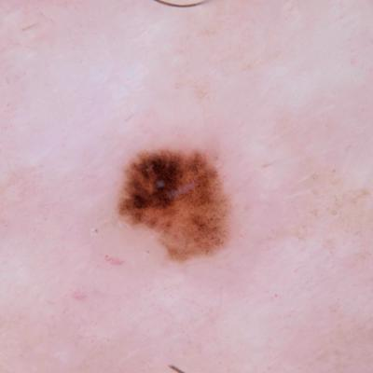
Problem
Skin cancer is a common cancer.
1.71% of the adult European population (= 7.3 million Europeans) reported having skin cancer.
cf. European Academy of Dermatology and Venereology (EADV) survey in 2022
Skin cancer is the most preventable cancer.
Skin cancer is not always obvious for non-specialists.
NV/ harmless
SCC/ cancerous

Slide 3
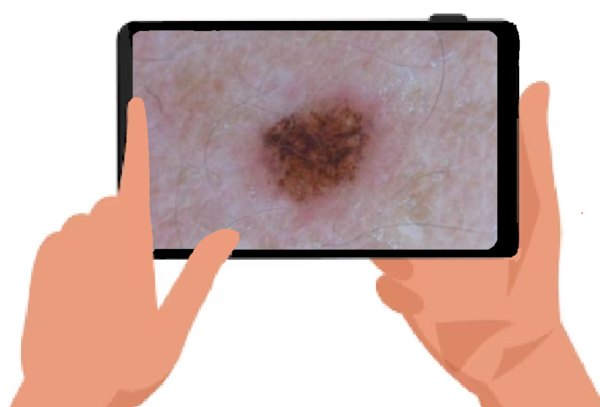
Solution
Your mole could be
Benign / NV type
Q. What is NV type?
A. NV type is...
Q. Should I consult a dermatologist?
A. Not urgent, but…
SKIN-SCANCER!
You upload a picture of your mole.
🔍SKIN-SCANCER will evaluate
whether it is malignant or benign
which kind of mole it is likely to be
🩺 SKIN-SCANCER will give you
information on the predicted type of mole
advice on what to do next

Slide 4
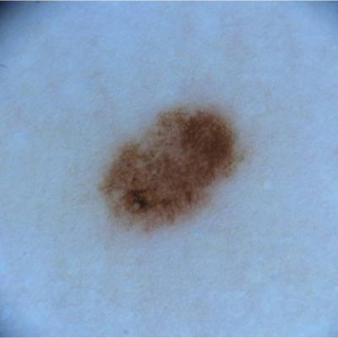
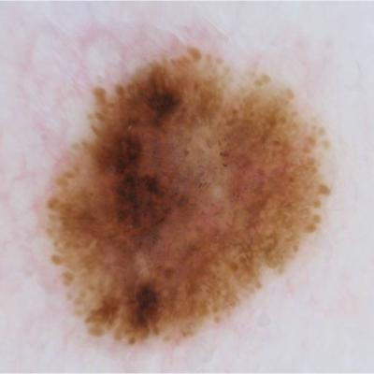
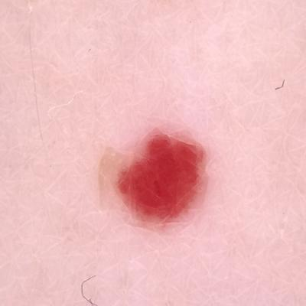
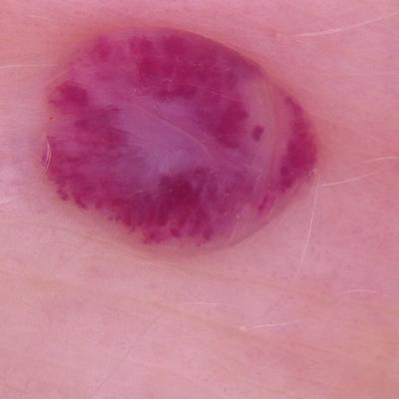
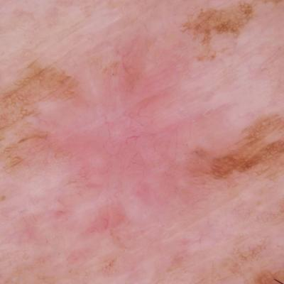
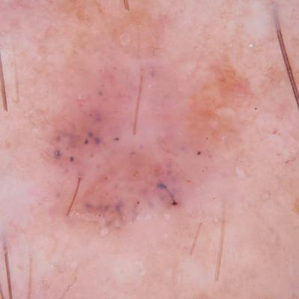
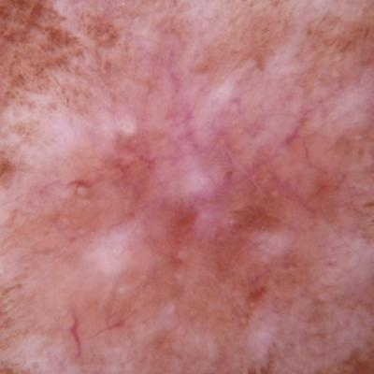
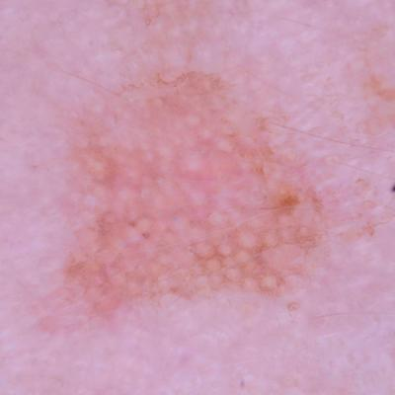
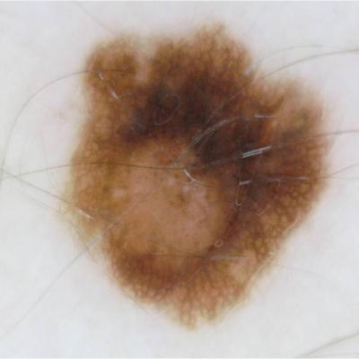
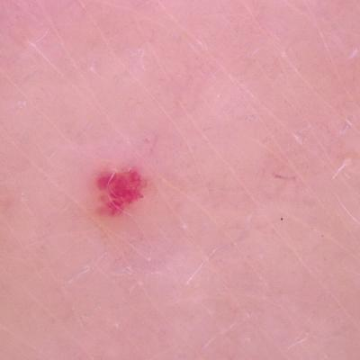
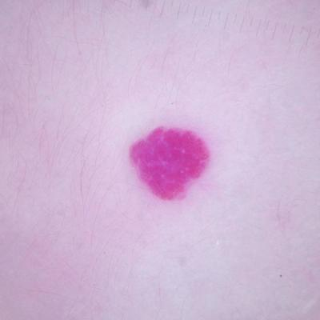
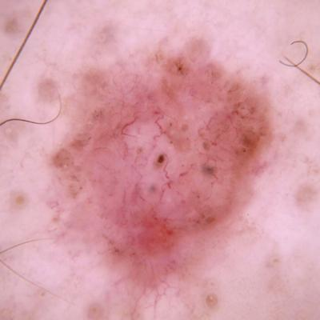
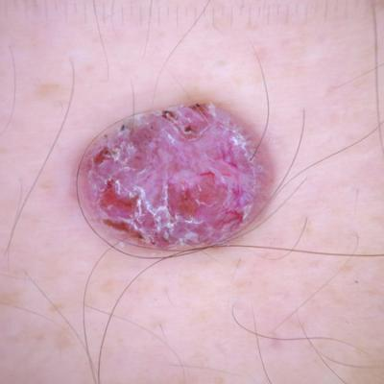
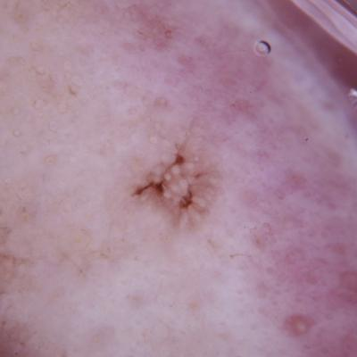
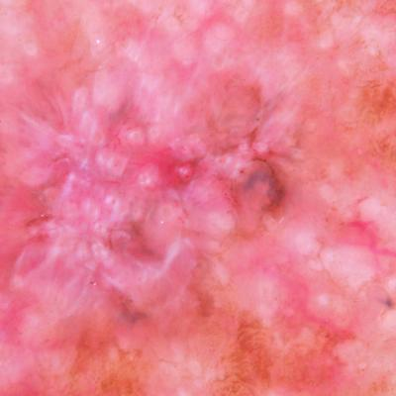
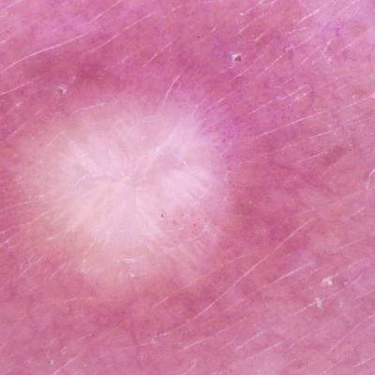
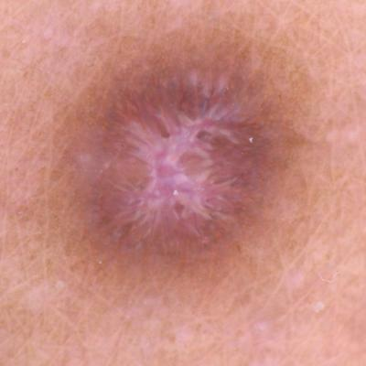
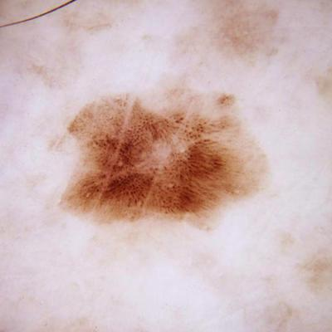
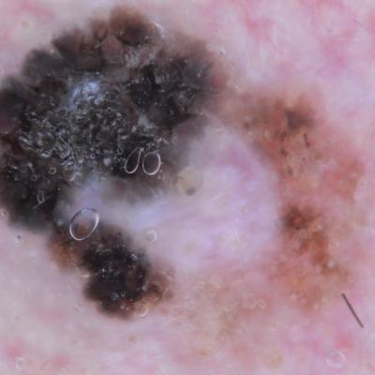
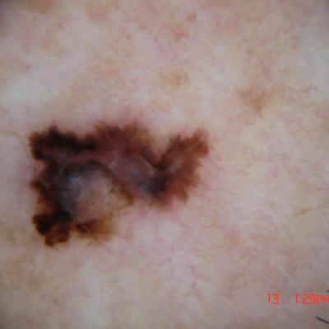
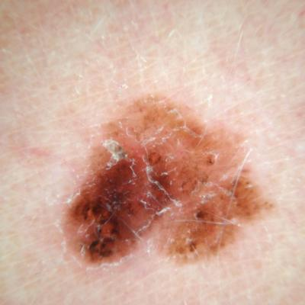
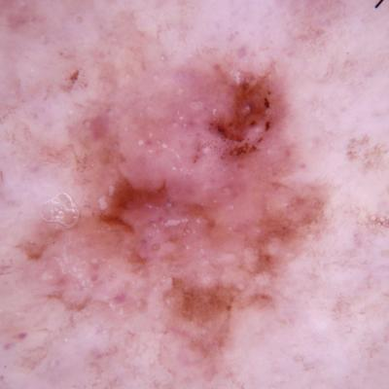
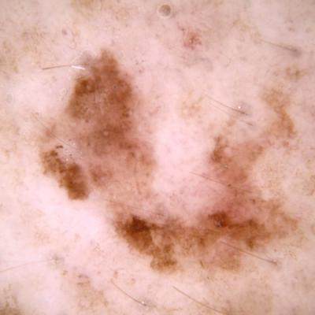
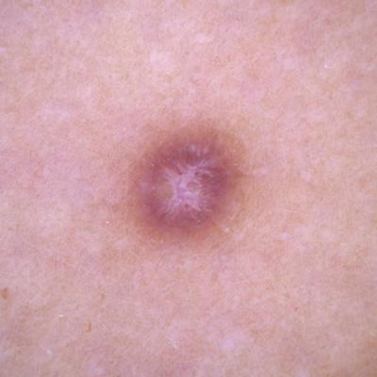
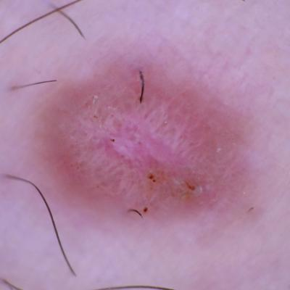
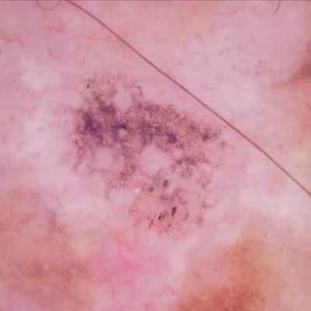
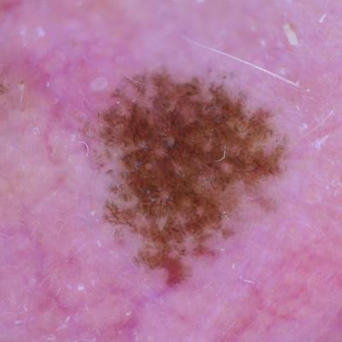
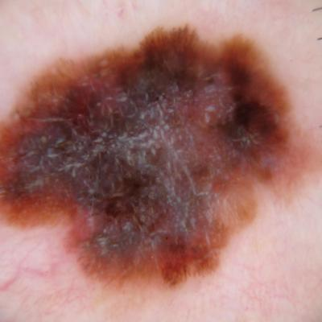
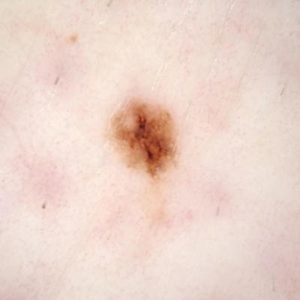
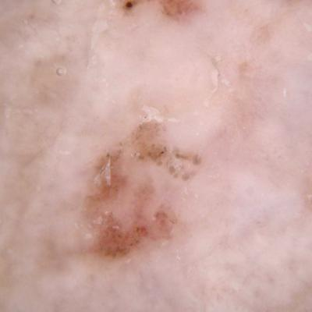
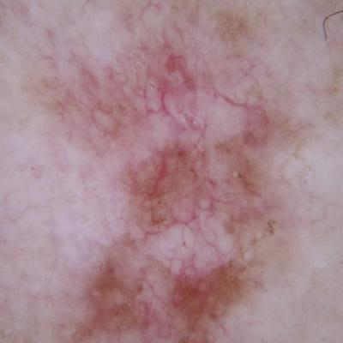
Dataset
Benign / Harmless
Malignant / Cancerous
NV (Melanocytic Nevus)
VASC (Vascular Lesion)
BCC (Basal Cell Carcinoma)
AK (Actinic Keratosis)
DF (Dermatofibromas )
BKL (Basal Cell Carcinoma)
MEL (Melanoma)
SCC (Squamous Cell Carcinoma)

Slide 5

How it works
Transfer Learning
ResNet50 Model
Input

Slide 6
Demo
Meet our SKIN-SCANCER

Slide 7
Challenges and future scope
DATA: Imbalanced data
MODEL: Improve the distinction between MEL and NV types

Slide 8
Thank you!

